Slide 1


CS-446: Information Systems Security
Chapter # 3: One Time Pad (OTP), Pseudorandom Generator (PRG) and Stream Ciphers
Lecturer Abdullah Bin Zarshaid
Department of Computer Science
FAST-NUCES

Slide 2
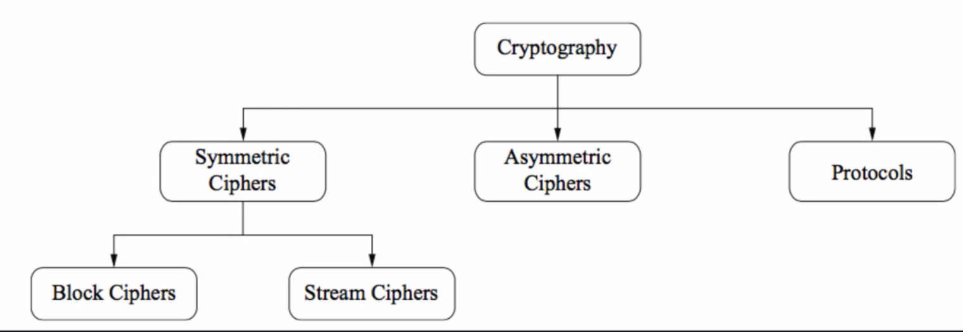

Slide 3
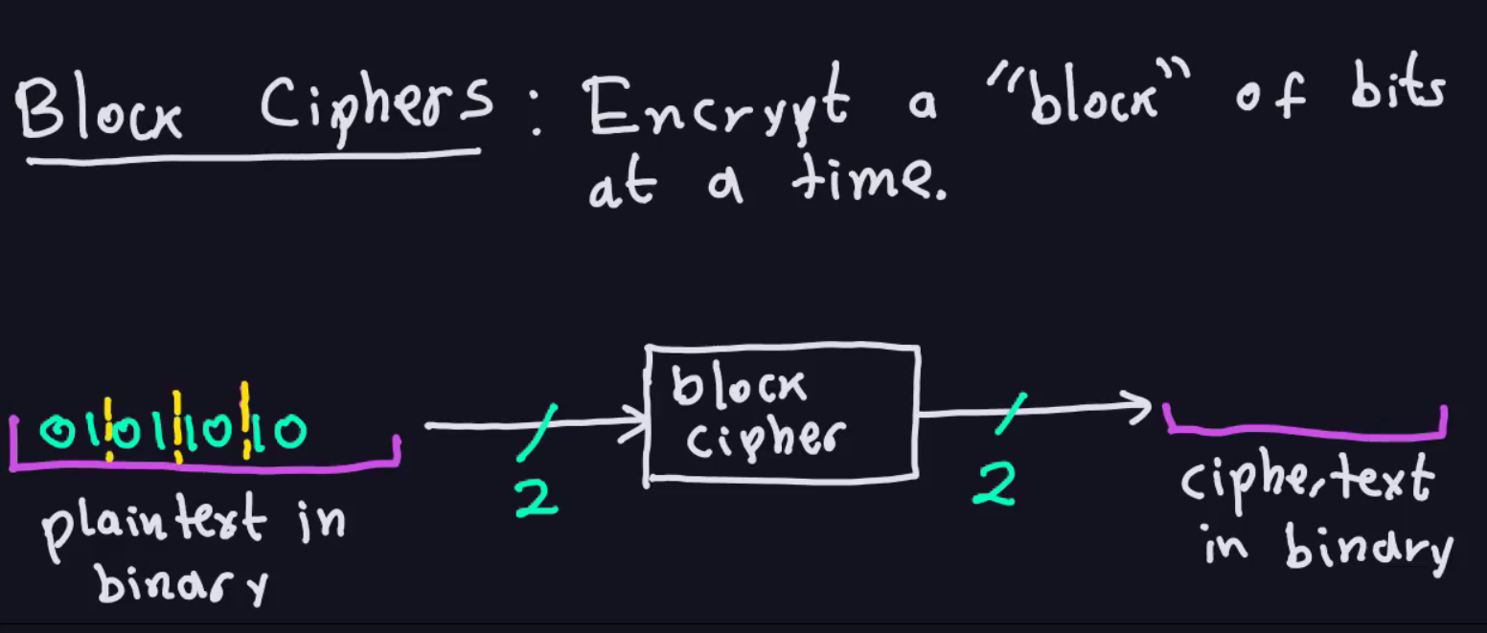

Slide 4
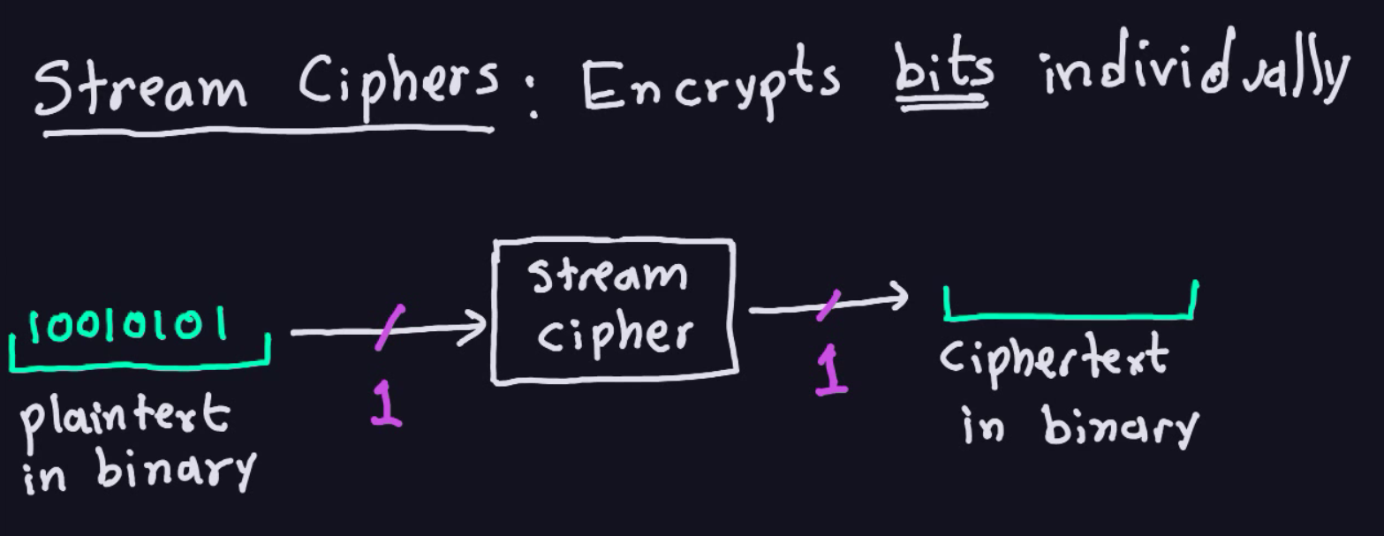

Slide 5
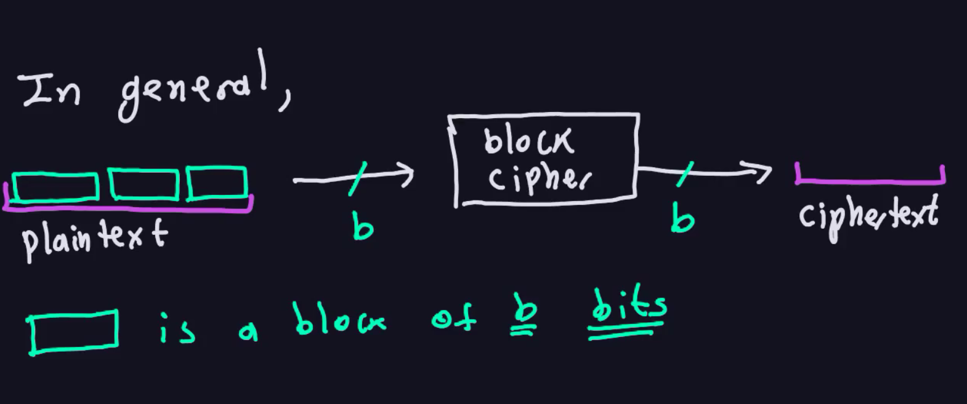

Slide 6
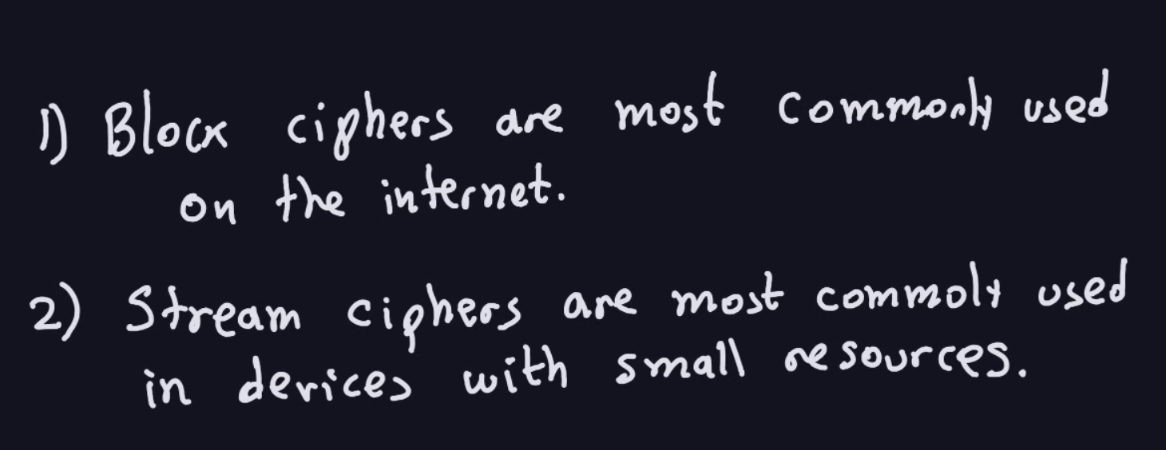

Slide 7
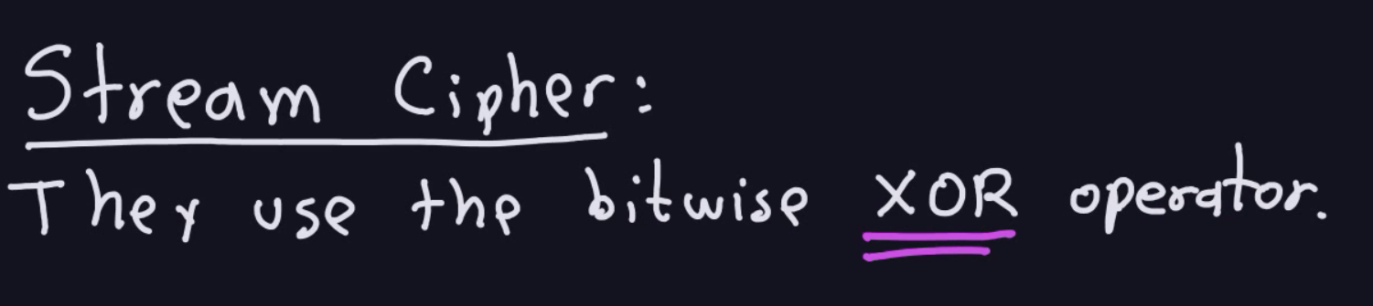

Slide 8
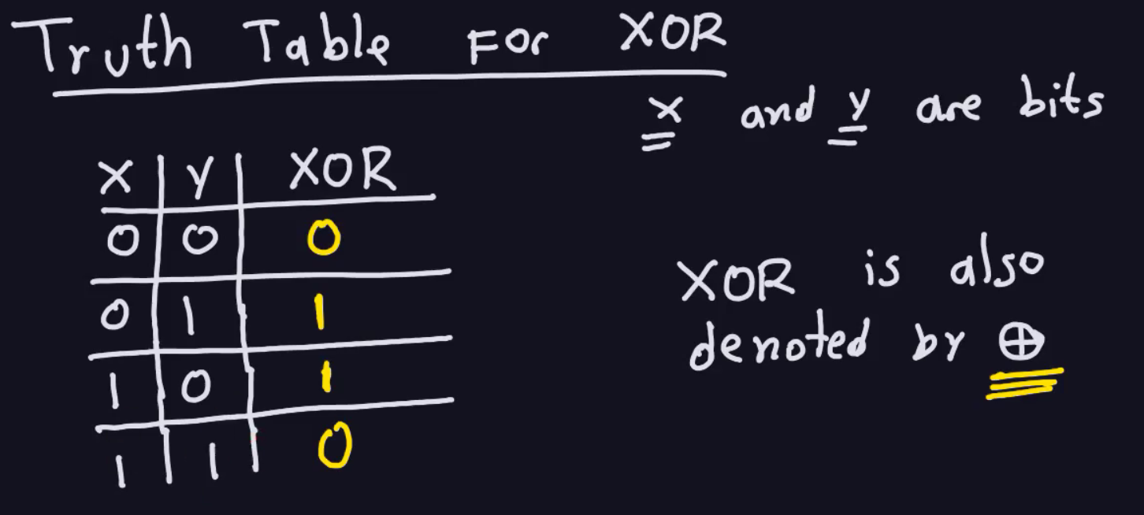

Slide 9
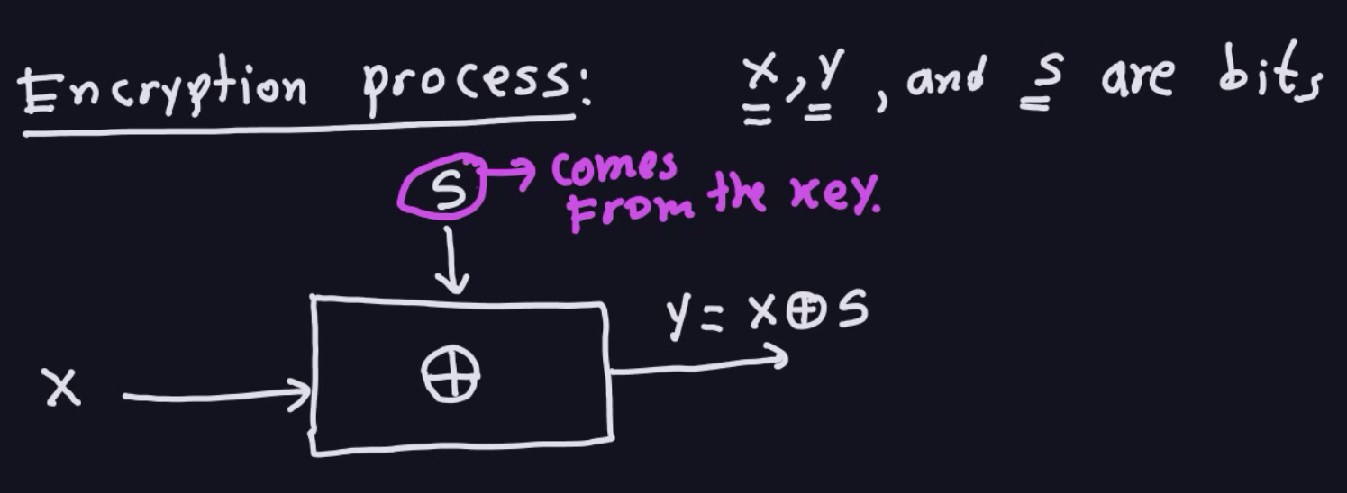

Slide 10
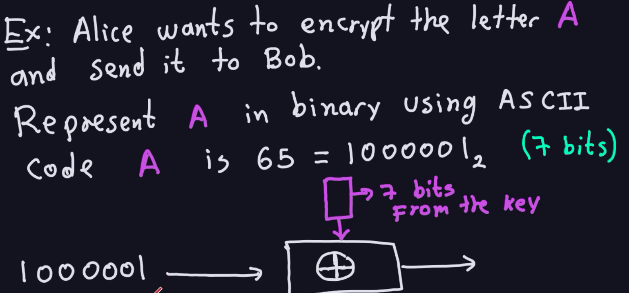

Slide 11
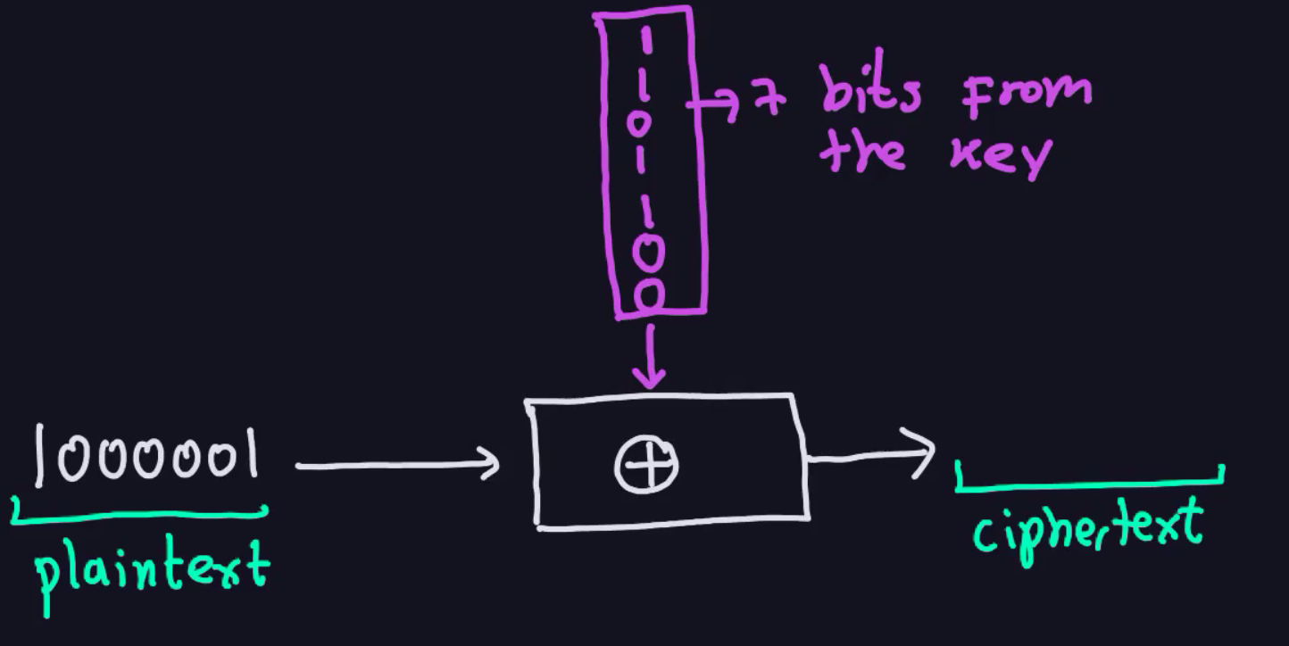

Slide 12
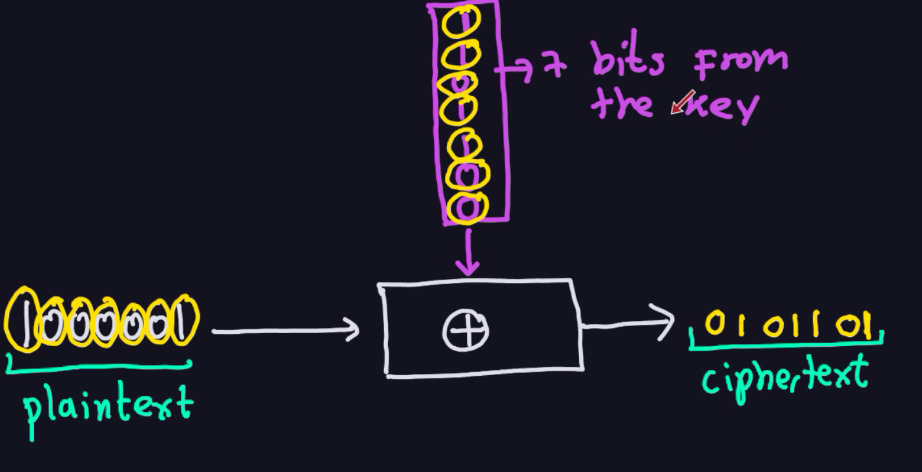

Slide 13
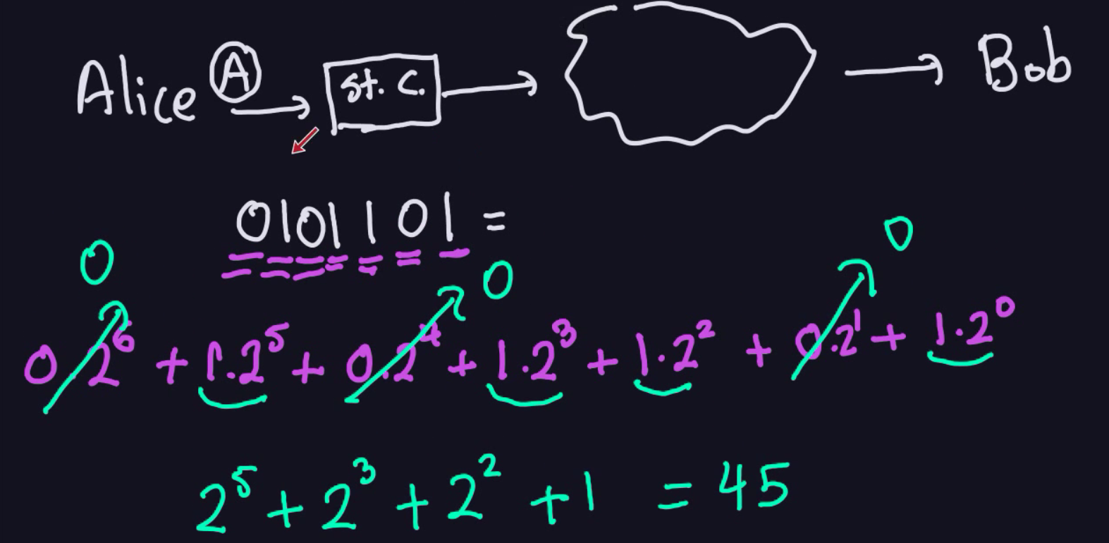
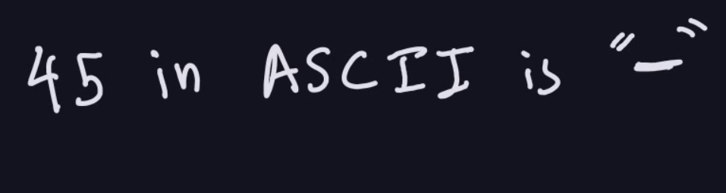

Slide 14
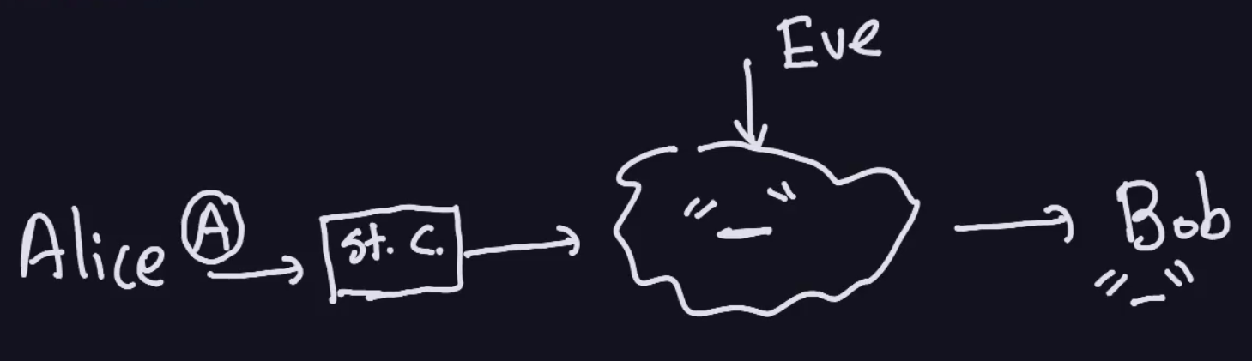

Slide 15
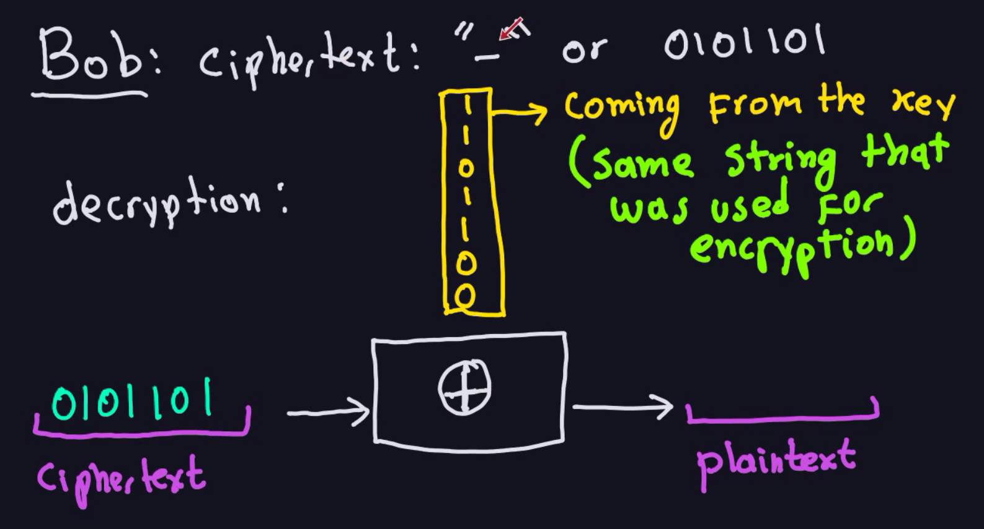

Slide 16
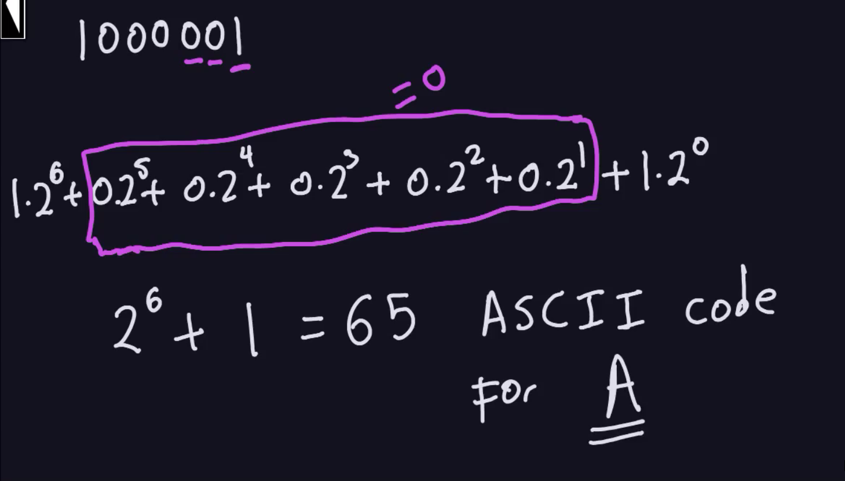

Slide 17
Symmetric Cryptosystems
Formal Definition:
Cryptosystem is defined over (K,M,C) and a pair of “efficient” algorithms (E, D) s.t.
∀ m∈M, k∈K and c∈C : E(k, m) = c, D(k, E(k, m) ) = m
Efficient means run in polynomial time
E is often randomized.
D is always deterministic.
Notes:
Picture of cipher

Slide 18
One Time Pad (Vernam 1917)
One Time Pad has perfect secrecy (i.e. no CT only attacks)
Based on simple XOR operation
M=C=K={0,1}^{n}
C:= E(k, m) = k ⊕ m
D(k, c) = k ⊕ c
Indeed
D(k, E(k, m)) = D(k, k ⊕ m) = k ⊕ (k ⊕ m) = (k ⊕ k) ⊕ m
= 0 ⊕ m = m
One-time pad = XOR cipher with constraints:
Key length equals message length
Key bits are truly random (not pseudo-random)
Key is used only once and destroyed
msg: 0 1 1 0 1 1 1
key: 1 0 1 1 0 1 0
CT: 1 1 0 1 1 0 1
⊕

Slide 19
You are given a message (m) and its OTP encryption (c).
Can you compute the OTP key from m and c ?
No, I cannot compute the key.
Yes, the key is k = m ⊕ c.
I can only compute half the bits of the key.
Yes, the key is k = m ⊕ m.

Slide 20
The One Time Pad (Vernam 1917)
Very fast enc/dec !!
… but long keys (as long as plaintext)
Is the OTP secure? What is a secure cipher?

Slide 21
What is a secure cipher?
Attacker’s abilities: CT only attack (for now)
Possible security requirements:
attempt #1: attacker cannot recover secret key
attempt #2: attacker cannot recover all of plaintext
Shannon’s idea:
CT should reveal no “info” about PT

Slide 22
Information Theoretic Security
Basic Idea: CT should reveal no “info” about PT
Def: A cipher (E,D) over (K,M,C) has perfect secrecy if
∀m₀, m₁ ∈M ( |m₀| = |m₁| ) and ∀c∈C
Pr[ E(k,m₀)=c ] = Pr[ E(k,m₁)=c ] where k ⟵K
Given CT can’t tell if msg is m0 or m1 ( for all m0, m1)
Most powerful adversary learns nothing about PT from CT
no CT only attacks !!! (but other attacks possible)
R
Notes:
Explain impications

Slide 23
Definition: A cipher (E,D) over (K,M,C) has perfect secrecy if ∀m0,m1∈ M, (|m0|) = (|m1|) and ∀c ∈ C, such that: Pr[E(k,m0)=c] = Pr[E(k,m1)=c] where k is a random variable that is uniformly sampled in the keyspace K

Slide 24
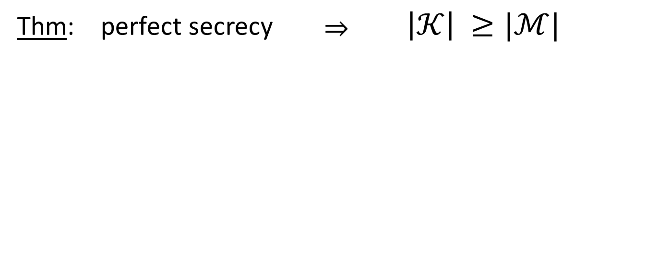
The bad news …
i.e. perfect secrecy ➔ key-len >= msg-len
Hard to use in practice !!!

Slide 25
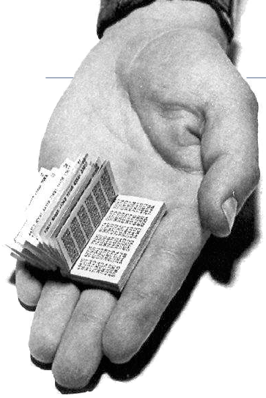
One Time Pad in practice
Intelligence and military services
Regular usage by KGB spies
Hotline between USA and USSR
Major problems
Key exchange difficult
True randomness required
Not very practical today
Inspiration for other methods,
e.g. stream ciphers

Slide 26
Unfortunately. We also said that Shannon proved this lema, we called it the bad news lema, that basically says that any cipher that has perfect secrecy must have really long keys.
In other words, the key length must be at least as long as the length of the message, which means that the cipher is not particularly useful.
Because if two parties have a way to agree on really long keys that are as long as the message, they, in some sense, might as well use that mechanism to already transmit the message itself.
So in upcoming slides we're going to take the idea of the one time pad and try to make it into a practical encryption scheme. So this is called what's called a stream cipher.

Slide 27
Stream Cipher: Pseudorandom Generators

Slide 28
So the idea in this stream cipher is rather than using a totally random key,
we're actually going to use a pseudo-random key.
So a PRG, really, all it is, is just a function, I'll call it G for generator, that takes a
seed, so I'm going to use zero one to the G: {0,1}^{s} s to denote all strings of length s, so this we'll call the seed space.
So he takes an s bit seed and maps it to a much larger string which will denote by G: {0,1}^{s} ⟶ {0,1}^{n} zero one to the n.
And the property is that n must be much larger than s. So in other words, we take a seed that might be only 128 bits and we expand it into a much, much larger output string that could be gigabytes long.
That's what this pseudo-random generator does. PRG is a Function G: {0,1}^{s} ⟶ {0,1}^{n}
s.t n >> s

Slide 29
And of course, the goal is that first of all, the generator is efficiently computable, so the function G.
There should be some sort of an efficient algorithm that computes it. So, efficiently computable by a deterministic algorithm.
It's important to understand that the function G itself has no more randomness, in it, it's a totally deterministic.
The only thing that's random here is the random seed, that's given as input to the function G. And the other property, of course, is that the output.

Slide 30
Stream Ciphers: making OTP practical
Idea: replace “random” key by “pseudorandom” key
PRG is a Function G: {0,1}^{s} ⟶ {0,1}^{n}
s.t n >> s
PRG is efficiently computable by a deterministic algorithm
Notes:
The PRNG-generated sequence is not truly random, because it is completely determined by a relatively small set of initial values, called the PRNG's seed (which may include truly random values)

Slide 31
So suppose we have a generator, how do we use that, to build a stream cipher?
The idea is that we will use the seed, as our key, so our short seed is will be our secret key. And then we will use the generator to basically expand the seed into a much, much larger random looking sequence, or pseudorandom sequence, as it's known, so this would be G(K).
And then we will XOR it just like in the one time pad we're going to XOR it the pseudorandom sequence with the message and that's going to give us the cipher text.

Slide 32
Stream Ciphers: making OTP practical
Key (K) is the seed used by G to generate the PRG
Security: PRG must be unpredictable
Notes:
Define stream cipher

Slide 33
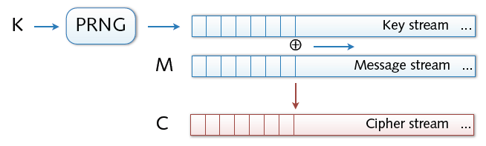
Stream Ciphers
Stream ciphers
Bit-wise encryption and decryption of data
Application of pseudo-random number generator (PRG)
XOR operation on pseudo-random keystream
Security solely depends on randomness of PRG

Slide 34
Stream Ciphers
Stream ciphers cannot have perfect secrecy !!
Need a different definition of security
Security will depend on specific PRG
Notes:
No more perfect secrecy

Slide 35
First of all we would need a different definition of security to argue that Stream cipher, is secure and in particular, the security property is going to depend on the specific generator that we used.
But for now let me show you one particular property. That a generator must have a minimum property needed for security. This property is called unpredictability.

Slide 36
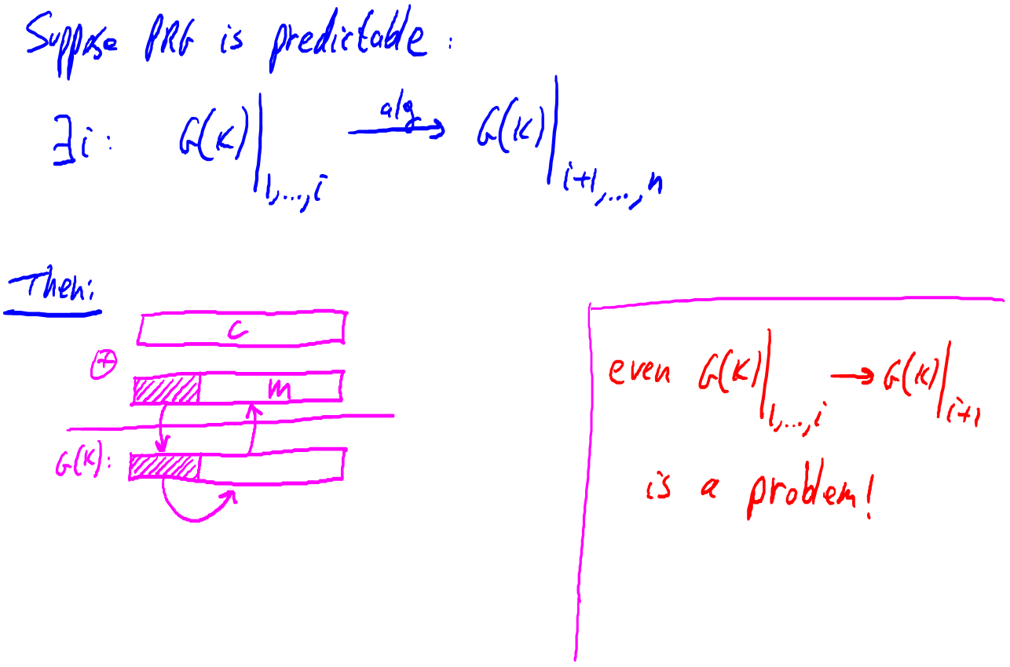
So let's we suppose for one second that in fact a stream cipher is predictable. So, what does that mean? Both the PRG is predictable.
What that means is essentially that there is some i bits. Such that if i give you the first (i) bits of the outputs.
This notation Bar G(K) 1 to (i) means look at the first i-bits of the output of the function. so I give you the first (i bits) of the stream.
There is some sort of an algorithm, there's an efficient algorithm that will compute the rest of the string.

Slide 37
Okay, so given the first (i) bits, you can compute the remainder of the bits.
I claim that if this is the case, then the stream cipher would not be secure.
So let's see why.
Suppose an attacker actually intercepts a particular cipher text, let's
call it c. If this is the case, then in fact, we have a problem.
Because suppose that just by some prior knowledge, the attacker actually knows that the initial ]part of the message happens to be some known value.

Slide 38
For example, we know that in the mail protocol, SMTP, the standard mail call used in the internet, you know that every message starts with a word from colon. Well, that would be a prefix that the adversary knows.
That the site, that the message must begin with from a colon.
What it could do is the cipher text with the words from colon, with the little prefix of the message that it actually knows.
And what that would give it is a prefix of the pseudorandom sequence. And I would learn as a result of this, it would learn a prefix of the pseudorandom sequence but then we know that once it has a prefix of the pseudorandom sequence it can predict the remainder of the pseudorandom sequence and that would allow it to then predict the rest of the message end.

Slide 39
So for example if the pseudorandom generator was predictable given five bits of the pad.
Then every email encrypted using the stream cipher would be decryptable because, again, the attacker knows the prefix of the message from which he deduces the prefix of the pad, which then allows him to compute the rest of the pad, which then allows him to recover the entire plain text.
So this is an example that shows that in fact if a PRG is predictable then already there are security problems. Because a small prefix would reveal the entire message.
As it turns out, even if I could predict just one bit of the outputs. Even if given, you know, the first (i) bits, I can predict the next bits, the (i) plus first bits. Already, this is a problem.
Because that would say that given again, the first couple of letters in a message can predict, can decrypt essentially, and recover the next bit of the message, or the next layer of the message, and so on.

Slide 40
So this predictability property shows that, you know, if we use a PRG that's going to be used in a stream cypher, it had better be unpredictable.

Slide 41
PRG must be unpredictable
Notes:
Suppose that PRG is predictable. This means that there exist some i s.t if I give you first i bits of the stream (from the PRG) there is some algo that can compute the remainder of the bits.
Attacker intercepts a Cipher
He also somehow know the initial part of the plain text M (e.g in SMTP From: the msg startt).
Based on that it can learn the prefix-of the PR sequence and can predict the remainder (if PRG is predictable)

Slide 42
PRG must be unpredictable
We say that G: K ⟶ {0,1}^{n} is predictable if:
Def: PRG is unpredictable if it is not predictable
⇒ ∀i: no “eff” adv. can predict bit (i+1) for “non-neg” ε
Notes:
Probability if I choose a random key
2^30 is 1 billion

Slide 43
AN EXAMPLE
Suppose I give you a generator, and I ask you, is it predictable? Well, this
generator happens to have the property, that if I XOR all the bits of the
outputs, I always happen to get =1.
So XOR all the bits. Bit number one, XOR bit number two, XOR bit number three.
If XOR all those bits, I happen to get =1.
The question is, is that a predictable generator?
(SEE NEXT SLIDE FOR ANSWERS)
.

Slide 44
Suppose G:K ⟶ {0,1}^{n} is such that for all k: XOR(G(k)) = 1
Is G predictable ??
Yes, given the first bit I can predict the second
No, G is unpredictable
Yes, given the first (n-1) bits I can predict the nth bit
It depends
And again, I hope everybody answered yes, that essentially given the first n minus one bits of the outputs, I can predict the nth bit because it would just be the bits that's needed to make the XOR all the bits be one.
In other words, I give you all but one of the bits of the generator, you can actually predict the last bit of
the generator. Now that we've seen that PRGs have to be unpredictable.
FAST-NUCES

Slide 46
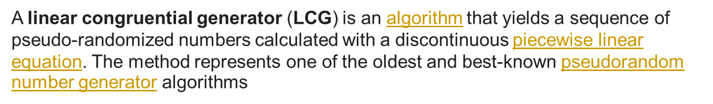
Weak PRGs (do not use for crypto)
With LCG small number of outputs can be use to predict remaining bits
glibc random():
Notes:
Linear Congrential Generator is not secure
a and b are integers
P is prime

Slide 47
So a very common PRG that should actually never be used for crypto is
called a linear congruential generator. So let me explain what a linear congruential
generator is.
Basically it has parameters. It has three parameters. I'll call them a, b and p.
a and b are just integers and p is a prime.
And the generator is defined as follows, essentially I'll say r[0] = is the seed of the generator. And then the way you generate randomness is basically you iteratively run through the following steps.
You compute a times r of I minus one plus b modular p. Then you output a
few bits of the current states, output few bits of our i. Then, of course, you
increment (i) and you iterate this again and again and again. Okay? So you can see how this generator proceeds. It starts with a particular seed. At every step there is
this Linear transformation that's being applied to the seed. And then you output a
few bits of the current state and then you do that again and again and again and
again. Unfortunately even though this generator has good statistical properties
in the sense that, for example, the number of zeroes it outputs is likely going to be
similar to the number of ones and so on; it has, you can actually argue all sorts
of nice statistical properties about this, nevertheless it is a very easy generator
to predict.

Slide 48
And in fact should never ever be used. In fact, just given a few outputs, a few output samples, it's easy to predict the remainder of the sequence. And as a result, this generator should never ever be used..
Another example is a random number generator that is very closely related to the linear congruential generator This is a random number generator implemented in glibc, very common library.
That you can see. I just wrote down the definition here. You can see that is basically outputs a few bits at every iteration and it just does this simple linear transformation at every step. Again, this is a very easy generator to predict and should never ever be used for crypto. And so the lesson I want to emphasize here is never ever use the built-in glibc function random.
For crypto, because it doesn't reduce, cryptographic randomness, in the sense that it is easy to predict.
And, in fact, systems like Kerberos version four have used random and, have been bitten by that. So, please don't make that mistake yourself.

Slide 49
CONCEPT of negligible and non-negligible values, so different communities in crypto actually define these concepts differently, for practitioners basically these the term negligible and non-negligible, are just, particular scalers that are used in the definition.
So, for example, a practitioner would say, that if a value is more than one over, one over a billion, one over two to the 30, we say that the value is non-negligible. The reason is, the reason that's so, is, because if you happen to use a key, for example, for, for encrypting a gigabyte of data, a gigabyte of data is about two to the 30 or maybe even two to the 32 bytes.
Then an event that happens with the probability one over two to the thirty will likely happen after about a gigabyte of data. So since a gigabyte of data is within reason for a particular key, this event is likely to happen. Therefore one over two to the thirty is non-negligible. On the other hand, we'll say that one over two to the eighty. Which is much, much, much smaller is an event, an event that happens with this probability is an event that's actually not going to happen over the life of the key. And therefore we'll say that that's a negligible event. As it turns out, these practical definitions of
negligible and non-negligible are quite problematic and we'll see examples of why
they're problematic later on.

Slide 50
So in fact in the more rigorous theory of cryptography, the definition of negligible and non-negligible are somewhat different.
And in fact, when we talk about the probability of an event, we don't talk about these probabilities as scalers, but rather we talk about them as functions of a security parameter. So let me explain what that means. So these functions, essentially, are functions that map, that outputs, positive real values.
So, are non negative real values that are supposedly probabilities.
But they're functions that act on non negative integers.
So, what does it mean for a function to be non-negligible? What it means is that the function is bigger than some polynomial infinitely often.
In other words, for many, for infinitely many values, the function is bigger than some, one over polynomial.
So if something is bigger, is often bigger than one of that polynomial, we'll say that it's non-negligible.
However, if something is smaller than all polynomials, then we'll say that it's negligible.

Slide 51
So, what this says here, basically, for any degree polynomial, for all d, there exists some lower bound lambda-d such as, for all lambda bigger than this lambda-d, the function is smaller than one over the polynomial.
So all this says is that the function is negligible if it's less than all polynomial fractions. In other words, is less than one over lambda-d for sufficiently large lambda. So let's look at some examples. And we'll see applications of these negligible and non-negligible concepts later on.
But I just want to make, wanted to make it clear that this is how you would rigorously find these concepts. Basically either smaller than one over poly or bigger than one over poly, one would be negligible, the other would be non-negligible.
Let's look at some examples. So, for example, a function that drops exponentially in
lambda clearly would be negligible because for any constant d there is a sufficiently
large, large lambda. Such as one over two to the lambda is less than one over lambda
to the d.

Slide 52
So this is clearly less than all polynomials. Over the function, say, one over lambda to a thousand, right. This is a function that grows very, very, very slowly.
It barely ever moves. Nevertheless, this function is non-negligible because if I set d to be 10,000, then clearly this function is bigger than one over lambda to the 10,000.
And so this function is bigger than some polynomial fraction. And lets look at a confusing example, just to be tricky. What do you think?

Slide 53
Suppose I have a function that for an odd lambda it happens to be exponentially small,
for even lambda, it happens to be polynomials small. Is this a negligible or non negligible function?
Well, by our definition this would a non-negligible function. And the intuition is, if a function happens to be only polynomials small, very often, that actually means that this event, you know, an event that happens with this probability, is already too large to be used in a real cryptosystem.
So the main points to remember here, are that these terms, basically, correspond to less than polynomial or more than polynomial, but throughout the course, we'll mostly use negligible to mean less than, than an exponential.
And non-negligible to mean, less than one over polynomial. So now we saw the core idea for converting the one time pad into a practical cipher.

Slide 54
Negligible and non-negligible
In practice: ε
ε non-neg: ε ≥ 1/2³⁰ (likely to happen over 1GB of data)
ε negligible: ε ≤ 1/2⁸⁰ (won’t happen over life of key)

Slide 55
Attacks on OTP and Stream Ciphers In this Lecture, we will look at attacks on the one time pad, and some things you need to be careful with when you use the stream cipher

Slide 56
And the first attack I want to talk about is what's called the two time pad attack, so remember that the one time pad is called "one time" pad because the pad can only be used to encrypt a single message. I want to show you that if the same pad is used to encrypt more than one message, then security goes out the window, and basically an eavesdropper can completely decrypt encrypted messages.
So let's look at an example. So here we have two messages m1 and m2 that are encrypted using the same pad. So the resulting cipher text, C1 and C2, again basically are encryptions of these messages, m1 and m2, but both are encrypted using the same pad.
Now suppose an eavesdropper intercepts C1 and C2, and he obtains, he basically has both C1 and C2.
The natural thing for the eavesdropper to do is actually compute the XOR of C1
and C2 and what does he get when he computes this XOR? So I hope everybody
sees that, basically, once you XOR C1 and C2, the pads cancel out, and
essentially, what comes out of this is the XOR of the plaintext messages.

Slide 57
And it turns out that English basically has enough redundancy, such that if I give
you the XOR of two plaintext messages, you can actually recover those
two messages completely.
More importantly for us is these messages are encoded using ASCII. In fact, ASCII encodings has enough redundancy, such that given the XOR of two ASCII encoded messages, you can recover the original messages back.
So, essentially, given these XORs, you can recover both messages. So the
thing to remember here is if you ever use the same pad to encrypt multiple messages an attack who intercepts the resulting ciphertexts can eventually recover the existing plaintexts without too much work.
So, the stream cipher key or the one time pad key should never ever, ever, ever be used more than once. So, let's look at some examples where this comes up in practice.
It's a very common mistake to use the stream cipher key, or a one time pad key more than once. Now, let me show you some examples where this comes up. So you know to avoid these mistakes, when you build your own systems.

Slide 58
Attack: two time pad is insecure !!
Never use stream cipher key more than once !!
C₁ ← m₁ ⊕ PRG(k)
C₂ ← m₂ ⊕ PRG(k)
Eavesdropper does:
C₁ ⊕ C₂ → m₁ ⊕ m₂
Enough redundancy in English and ASCII encoding that:
m₁ ⊕ m₂ → m₁ , m₂
Notes:
C₁ ⊕ C_{2 the pads} cancel out and m₁ ⊕ m_{2 is left}

Slide 59
The first example is a historic example. At the beginning of
the 1940s, where the Russians actually used a one time pad to encrypt various
mesages.
Unfortunately, the pads that they were using were generated by a human by
throwing dice. And so, you know, the human would throw these dice, and write down the results of these throws.
And the collected throws would then form the pads that were used for encryption.
Now, because it was kind of laborious for them to generate these pads, it seems wasteful to use the pads to encrypt just one message.
So the ended up using these pads to encrypt multiple messages. And US intelligence was actually able to intercept these two time pads.

Slide 60
These ciphertexts that were encrypted using the same pad, applied to different messages. And it turns out, over a period of several years, they we're able to decrypt something like 3,000 plain texts just by intercepting these ciphertexts. The project is called Project Venona
It's actually a fascinating of cryptanalysis, just because the two time pad is insecure. More importantly, I want to talk about more recent examples that come up in networking protocols, so let me give you an example from Windows NT, in a product called the, point-to-point transfer protocol.
This is a protocol for a client wishing to communicate securely with a server. The
client and the server both share a secret key here, and they both send messages to
one another. So, here, we'll denote the messages from the client by m1. So, the
client sends a message, the server responds, the client sends a message, the
server responds, the client sends a message, the server responds, and so on
and so forth.

Slide 61
Now, the way PPTP works is, basically, the entire interaction, from the client to the server, is considered as one stream. In other words, what happens is, the messages m1, and m2 and m3, are kind of viewed as one long stream.
Here, these two parallel lines means concatenation. So, essentially, we're
concatenating all the messages from the client to the server into one long stream.
And all that stream is encrypted using the stream cipher with key K. So that's
perfectly fine

Slide 62
I mean, there's nothing wrong with that. This messages are encrypted, are treated as one long stream, and they're all encrypted using the same key. The problem is, the same thing is happening also on the server side.
In other words, all the messages from the server are also treated as one long stream.
So here, they're all concatenated together. And encrypted using, unfortunately, the same pseudo-random seed, in other words, using the same stream cipher key. So basically what's happening here is you see an effect that the two time pad is taking place where the set of messages from the client is encrypted using the same one time pad as a set of messages from the server.
The lesson here is that you should never use the same key to encrypt traffic in both directions.
In fact, what you need to do is have one key for interaction between the client and the server and one key for interaction between the server and the
client

Slide 63
The way I like to write this is really that the shared key k really is a pair of keys.
One key is used to encrypt messages from server to client, and one key is used to encrypt messages from client to server.
So these are two separate keys that are used, and both sides, of course, know this key.
So both sides have this pair of keys, okay? and they can both encrypt. So one is used to encrypt messages in one direction and one is used to encrypt messages in the other direction

Slide 64


Real world examples
Project Venona (1941-1946)
Roll a dice a compute a pad. This seems boring and they started using the same pads again and again. Soviet messages sent from 1941 to 1946, decrypted about 3000 messages.
MS-PPTP (windows NT):
k
k
Need different keys for C⟶S and S⟶C
Notes:
Venona: Roll a dice a compute a pad. This seems boring and they started using the same pads again and again. soviet messages sent from 1941 to 1946, decrypted about 3000 messages.
MS- Point to Point transfer protocol.

Slide 65
So another important example of the two time pad comes up in Wi-Fi communication, particularity in the 802.11b protocol. So all of you I'm sure know that the 802.11 contains an encryption layer and the original encryption layer was called WEP and WEP fortunately for us is actually a very badly designed protocol so that I can always use it as an example of how not to do things.
There are many, many mistakes inside of WEP and here I want to use it as an example of how the two time pad came about.
So in WEP, there's a client and, and access point. They both share a secret key K. And then, when they will transmit a message to one another.

Slide 66
Let's say the client wants to send. A frame containing the plain text M to the access point, what he would do is first of all he appends some sort of check sum to this plain text.
The check sum is not important at this point, what is important is then this new
calculation gets encrypted using a stream cypher where the stream cypher key is this
concatenation of a value IV and a long term key K.
So this IV is a 24 bit string.
Okay, this IV is a 24 bit string, and you can imagine that it starts from zero and
perhaps it's a counter that counts increments by one for every packet.
The reason they did this was the designers of WEP realized that in a stream cypher, the key is only supposed to be used to encrypt one message. So they said well, let's go ahead and change the key after every frame. And the way they changed the key
essentially was by prepending this IV to it

Slide 67
And you notice this I-V changes on every packet.
So it increments by one on every packet. And the idea, then, is sent in the clear along with the cipher text. So the recipient knows the key K. He knows what the I-V is. He can retrieve the PRG of IV concatenating K. And then decrypts the cipher text to recover the original message M.
Now the problem with this of course is the IV is only 24 bits long. Which means that there are only two to the 24 possible IV's. Which means that after sixteen million frames are transmitted. Essentially the IV has to cycle. And once it cycles after 60 million frames.
Essentially we get a two time path. The same IV will be used to encrypt two
different messages. The TK never changes. It's a long term key. And as a result,
that same key, namely the IV concatenated K would be used to encrypt two different frames, and the attacker can then figure out the plain text of both frames.
So that's one problem. And the worst problem is in fact that on many 80211 cards, if you powercycle the card, the IV will reset back to zero.

Slide 68
And as a result, every time you power cycle the card, essentially you'll be encrypting the next payload using zero concatenated K So after every power cycle, you'll be using the zero concatenated K key to encrypt many, many, many times the same packets.
So you see how in WEP, the same pad could be used to encrypt many different messages as soon as the IV is repeated. There is nothing to prevent the IV from repeating after a power cycle.
Or am repeating after every sixteen million frames which isn't that many frames in a busy network. So while we are talking about WEP. I want to mention one more mistake that was done in WEP.
This is a pretty significant mistake and let's see how we might design it better. So you notice that the designers of WEP basically wanted to use a different key for every packet. Okay. So every frame is encrypted using a different key is concatenation of IV and K.
Unfortunately. They didn't randomize the keys and the keys are actually, if you
look at the key for frame number one, well, you know, it will be this concatenation of one and k. We'll just feel this 24 bits..

Slide 69
Then the key for frame number two is the concatenation of two and k. The key for frame number three is the concatenation of three and k. So the keys are very closely related to one another.
And I should probably mention also that these keys themselves can be 104 bits so
that the resulting PRG key. Is actually 104 plus 24 bytes which is 128 bytes.
Unfortunately these keys are very much related to one another. These are not
random keys. You notice they all have the same suffix of 104 bytes.
And it turns out the pseudo-random generator used in WEP is not designed to be secure when you use related keys that are so closely related. In other words, the majority of these keys are basically the same.
And in fact, for the PRG that's used in WEP. That PRG is called, RC4.

Slide 70
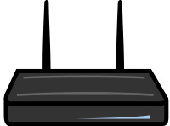
Real world examples
802.11b WEP:
Length of IV: 24 bits
Repeated IV after 2²⁴ ≈ 16M frames
On some 802.11 cards: IV resets to 0 after power cycle
m
CRC(m)
k
PRG( IV ll k )
k
IV
ciphetext
Notes:
Another example of two time pad
A very good example of how not to do
client and AP shared a Key
In order to change the key they appended it with IV. IV is incremented by one for each frame
The design realized that in stream cipher a Key must be used to encrypt one message so they design to change the key for every single frame.
IV changes and Key never changes
So Essentially the IV will be used again and it becomes 2 time pad

Slide 71
It was discovered by Fluhrer, Mantin and Shamir back in 2001, that shows that after about ten to the six of, after about a million frames.
You can recover the secret key. So, this is kind of a disastrous attack that says essentially all you have to do is listen to a million frames.
These frames basically. As we said they're all generated from a very common seed, namely a 104 bits of these seeds are all the same. The fact that they've used such closely related keys is enough to actually recover the original key.
And it turns out even after the 2001 attack, better attacks have come out that show
that these related keys are very much disastrous and in fact these days something like 40,000 frames are sufficient.
And so that, within a matter of minutes, you can actually recover the secret key in any WEP network. So WEP provides no security at all for two reasons. First of all, it can
resolve in the two time pad. But more significantly, because these keys are so
closely related, it's actually possible to recover the key by watching just a few
cipher texts. And by the way, we'll see that well, when we do a security analysis
of these steps of constructions. In a few segments, we'll start talking about how to
analyse these steps of constructions

Slide 72
Avoid related keys
802.11b WEP:
key for frame #1: (1 II k)
key for frame #2: (2 II k)
m
CRC(m)
k
PRG( IV II k )
k
IV
ciphetext
⋮
Notes:
FMS -→ florain martin and shamir
Within minutes you can recover the key for any WEP network
Here the keys are so much related that the keys can be recovered by just using few cipher texts
What the designers should have done ? Listen to the talk again

Slide 73
A better construction
k
PRG
k
⇒ now each frame has a pseudorandom key
better solution: use stronger encryption method (as in WPA2)

Slide 74
We'll see that when we have related keys like this, in fact, our security analysis will fail. We won't be able to get the proof to go through.
So one could ask what should the designers of a WEP should have done, instead?
Well, one approach is to basically treat the frames, you know M1, M2, M3. Each, each one is a separate frame transmitter from the client to the server.
He could have treated them as one long stream, and then XOR them potentially. Using the pseudorandom generator as one long stream.
So the first segment of the pad would have been used to encrypt M1. The second
segment of the pad would have been used to encrypt M2. The third segment
of the pad would have been used to encrypt M3.
And so on and so forth. So they basically could never have had to change the key because the entire interaction is viewed as one long stream. But they chose to have a different key for every frame.
So if you want to do that, a better way to do that is, rather than slightly modifying this IV that just slightly modifies the prefix of the key, of the PRG key. A better way to do that is to use a PRG again.

Slide 75
So essentially, what you could do is you will take your long term key. And then feed that directly through a PRG.
So now we get a long stream of bits that look essentially random.
And then the initial segment could be used, the first segment could be used as
the key, or frame number one.
And then the second segment would be used as the key for, you know, key for frame number two. And so on and so forth.
The third segment would be used to encrypt frame #three and so on and so forth,
Essentially, by doing this, each frame has a pseudo-random key. These keys, now, have no relation to one another. They look like random keys.
And as a result, if the PRG is secure for random Cs, it was also be secure on this
input. Because these keys essentially look as though they're independent of one
another. We'll see how to do this analysis formally once we talk about these types of
constructions. Since this two-time pad attack comes up so often in practice, it's
such a common mistake, I want to give one more example where it comes up so you know how to avoid it.

Slide 76
Two time pad: summary
Never use stream cipher key more than once !!
Network traffic: negotiate new key for every session (e.g. TLS)
Disk encryption: typically do not use a stream cipher

Slide 77
Attack 2: No Integrity (OTP is malleable)
enc ( ⊕k )
m
m⊕k
⊕
p
dec ( ⊕k )
m⊕p
(m⊕k)⊕p
Modifications to ciphertext are undetected and have predictable impact on plaintext
Notes:
If you modify the cipher text the changes are undetected. Whatever you add to the cipher text will have the same predictable effect on the decrypted message

Slide 78
Next attack I want to mention. Is a fact that the one time path and stream ciphers in general provide no integrity at all.
All they do is they try to provide confidentiality when the key's only used once.
They provide no integrity at all but even worse than that it's actually very easy to modify cipher text and have known effects on the corresponding plain text.
This property, by the way, is called malleability.
So imagine we have some message M that gets encrypted. So, here, it gets encrypted using a stream cipher. And the cipher text, of course, is then gonna be, M XOR K. (See last slide to understand the described info )
Now an attacker intercepts the cipher text. Well, that doesn't tell him what the plain text is but what he can do is now beyond eavesdropping he can actually become an active attacker and modify the cipher text.
So when I say modify the cipher text let's suppose that he XOR the cipher text with a certain value P. What's called a sub-permutation key.

Slide 79
Well, the resulting cipher text then becomes M XOR K, XOR P.
So now I'll ask you, when we decrypt the cipher text, what is it going to decrypt to? Well I hope everybody sees manipulating the XORs Basically the decryption becomes M XOR P.
So you notice that by XOR with this pad P, the attacker was able to have a very specific effect on the resulting plain text.
So a summary is basically you can modify the cipher text. These modifications are undetected.
But even worse, they're undetected, they have a very specific impact on the resulting plain text.
Namely whatever you XOR the cipher text with is going to have that exact effect on the plain text.

Slide 80
Attack 2: No Integrity
enc ( ⊕k )
From: Bob
From: Bob
⊕
⋯
dec ( ⊕k )
From: Eve
From: Eve
Modifications to ciphertext are undetected and have predictable impact on plaintext
Notes:
Bob: 42 6F 62 , Eve: 45 76 65 , Bob ⊕ Eve: 07 19 07

Slide 81
Explanation of last slide:
So to see where this can be dangerous, let's look at a particular example. Suppose the user sends an email that starts with the words from Bob. In the attacker intercepts the corresponding cipher text.
He doesn't know what the cipher text is but let's just for the sake of it let's
pretend that he actually knows that this message is actually from Bob.
What he wants to do is he wants to modify the cipher text so that the plain text would
now look like it came from somebody else. Say, he wants to make it look like this
message actually came from Alice. All he has is the ciphertext. Well, what he can
do is he can XOR with a certain three characters.

Slide 82
We'll see what those three characters are in just a second. And such that the resulting
ciphertext is actually an encryption of the message from Eve. And so that now when
the user decrypts that.
All of a sudden he'll see, Hey, this message is from Eve. It's not, he'll think thismessage is from Eve, not from Bob.
And that might cause you know, the wrong thing to take place. So here the attacker, even though he himself could not have created a cipher text that says from Eve, by modifying an existing cipher text all of a sudden he was able to make the cypher text that he could not have done without intercepting at least one cipher text.
So again by intercepting one cipher text he was able to change it so not it looks like it's
from Eve, rather than from Bob. So just to be specific, let's look what these three
characters need to be, so let's look at the word Bob. And I'm going to write it in
ASCII. So Bob in ASCII corresponds to 42 hex six f hex and 62 hex. So little b is
encoded as 62, little o is encoded as six f. The word eve is encoded as 45 hex, 76
hex, and 65 hex.

Slide 83
Now when I XOR these two words, I'm literally going to XOR them as bit strings.
So Bob XOR eve, it's not difficult to see that what I get are the three characters zero, seven. Nineteen and 07.
So really what these three characters here are going to be. Are simply 07, nineteen, and 07.
And by XORing these three characters at the right positions into the cipher text, the
attacker was able to chance the cipher text to look like it came from Eve rather
than from Bob. So this is an example where having a predictable impact on the
cipher text can actually cause quite a bit of problems. And this is this property
called malleability. And we say that the one time pad is malleable because it's
very easy to compute in cipher texts, and make prescribed changes to the
corresponding plain text. So to prevent all this, we will basically show how to add integrity to encryption mechanisms in general.
But right now I want you to remember that the one time pad by itself has no integrity and is completely insecure against attackers that actually modify the cipher texts.

Slide 84
Real-world Stream Ciphers

Slide 85
RC4 Cipher
Common stream cipher
Developed by Ron Rivest for RSA Security
Leaked to the public in 1994 (ARC4 = Alleged RC4)
Key size (seed): 40 to 256 bits
Some known weaknesses, e.g., in WEP implementation

Slide 86
The first stream cipher I want to talk about is called RC4, designed back in 1987. Below is the high-level description of it.
So RC4 takes a variable size seed, here I just gave as an example where it would take 128 bits as the seed size, which would then be used as the key for the stream cipher.
The first thing it does, is it expands the 128-bit secret key into 2,048 bits, which
Will be used as the internal state for the generator. And then, once it's done
this expansion, it basically executes a very simple loop, where every iteration of
this loop outputs one byte of output.
So, essentially, you can run the generator for as long as you want, and generate one byte at a time. Now RC4 is actually, as I said, fairly popular. It's used in the HTTPS protocol quite commonly actually.

Slide 87
These days, for example, Google uses RC4 in its HTTPS. It's also used in WEP as we discussed in the last segment, but of course in WEP, it's used incorrectly and
it's completely insecure the way it's used inside of WEP.
So over the years, some weaknesses have been found in RC4, and as a result, it's recommended that new projects actually not use RC4 but rather use a more modern pseudo-random generator.

Slide 88

Old example (software): RC4 (1987)
2048 bits
128 bits
1 byte
per round
seed
Used in HTTPS and WEP
Weaknesses:
Bias in initial output: Pr[ 2nd byte = 0 ] = 2/256
Prob. of (0,0) is 1/256² + 1/256³ (happens in GBs of Data)
Related key attacks
Notes:
According to Dan Boneh RC4 should not be used any more
Extends 128 bits to 2048 bits are used as internal state for the generator. Run a Fairly simple loop and output 1 Byte of out as long as required.
If RC4 is random then 2nd byte’s probability to be 0 is double. This means that there is no encryption at 2nd byte
Since first 2 bytes output are bias. It is recommended to start using from 257 bytes
If you observer the very long set of RC4 it turns out that the probability of any two consecutive bytes (0,0) is more often

Slide 89
So let me just mention two of the weaknesses.
So the first one is, if you look at the second byte of the output of RC4. It turns out the second byte is slightly biased.
If RC4 was completely random, the probability that the second byte happens to be equal to zero would be exactly 1/256.
There are 256 possible bytes, the probability that it's zero should be 1/256.
It so happens that for RC4 the probability is actually 2/256, which means that if you use the RC4 output to encrypt a message the second byte is likely to not be encrypted at all.
In other words it'll be XOR-ed with zero with twice the probability that it's supposed to.
So 2/256, instead of 1/256. And by the way I should say that there's nothing special about the second byte. It turns out the first and the third bytes are also biased.

Slide 90
And in fact it's now recommended that if you will use RC4, what you should do is ignore basically the first 256 bytes of the output and just start using the output of the generator starting from byte 257.
The first couple of bytes turned out to be biased, so you just ignore them.

Slide 91
The second attack that was discovered is that in fact if you look at a very long output of RC4 it so happens that you're more likely to get the sequence (0,0) .
In other words, you're more likely to get sixteen bits, two bytes of zero, than you should.
Prob. of (0,0) is 1/256² + 1/256³ (happens in GBs of Data)
Again, if RC4 was completely random the probability of seeing zero would be exactly 1/256 squared.
It turns out RC4 is a little biased and the bias is 1/256 cubed.
It turns out this bias actually starts after several gigabytes of data are produced by
RC4.
But nevertheless, this is something that can be used to predict the generator and definitely it can be used to distinguish the output of the generator from a truly random sequence.
Basically the fact that zero appears more often than it should is the distinguisher.

Slide 92
And then in the last segment we talked about related-key attacks that were used to attack WEP, that basically say that if one uses keys that are closely related to one another then it's actually possible to recover the root key.
So these are the weaknesses that are known of RC4 and, as a result, it's recommended that new systems actually not use RC4 and instead use a modern pseudo-random generator

Slide 93
Second example is of a badly broken stream cipher that's used for encrypting DVD movies.
When you buy a DVD in the store, the actual movie is encrypted using a stream cipher called the content scrambling system, CSS.
CSS turns out to be a badly broken stream cipher, and we can very easily break it.
We're doing it so you can see an example of an attack algorithm, but in
fact, there are many systems out there that basically use this attack to decrypt
encrypted DVDs.
So the CSS stream cipher is based on something that hardware designers like. It's designed to be a hardware stream cipher that is supposed to be easy to implement in hardware, and is based on a mechanism called a linear feedback shift register.
So a linear feedback shift register is basically a register that consists of cells where each cell contains one bit.

Slide 94
Old example (hardware): CSS (badly broken)
Linear feedback shift register (LFSR):
Notes:
This is what hardware designer likes. Easy to implement in the hardware.
There are taps at certain position and they are feed into the Xor and that become an input to the register on clock cycle and the right side the bit is resulted in output.
Implemented in hardware so hard to change

Slide 95
Then basically what happens is there are these taps into certain cells, not all the cells, certain positions are called taps.
And then these taps feed into an XOR and then at every clock cycle, the shift register shifts to the left.
The last bit falls off and then the first bit becomes the result of this XOR.
So you can see that this is a very simple mechanism to implement, and in hardware takes very few transistors.
Just the shift right, the last bit falls off and the first bit just becomes the XOR of the previous bits.
So the seed for this LFSR basically, is the initial state of the LFSR.
And it is the basis of a number of stream ciphers.

Slide 96
So here are some examples.
DVD encryption uses two LFSRs. == DVD encryption (CSS): 2 LFSRs
GSM encryption, these are algorithms called GSM encryption (A5/1,2): 3 LFSRs. And that uses three LFSRs.
Bluetooth encryption is an algorithm called, E(0). These are all
stream ciphers, and that uses four LFSRs. == Bluetooth (E0): 4 LFSRs
They all Turns out to be badly broken, and actually really should not be trusted for encrypting traffic, but they're all implemented in hardware, so it's a little difficult now to change what the hardware does.

Slide 97
So, let's describe how CSS actually works. So, the key for CSS is five bytes, namely 40 bits, five times eight is 40 bits.
The reason they had to limit themselves to only 40 bits is that DVD encryption was
designed at a time where U.S. Export regulations only allowed for export of
crpyto algorithms where the key was only 40 bits.
So the designers of CSS were already limited to very, very short keys. Just 40 bit keys.
So, their design works as follows. Basically, CSS uses two LFSR's. One is a 17-bit LFSR.
In other words, the register contains 17 bits. And the other one is a 25-bit LFSR,
it's a little bit longer, 25-bit LFSR.

Slide 98
And the way these LFSRs are seeded is as follows. So the key for the encryption, basically looks as follows.
You start off with a one, and you concatenate to it the first two bytes of
the key.
And that's the initial state of the LFSR.
And then the second LFSR basically is initialized the same way.
One concatenated the last three bytes of the key. And that's loaded into the initial state of the LFSR.
You can see that the first two bytes are sixteen bits, plus leading one, that's seventeen bits overall, whereas the second LFSR is 24 bits plus one which is 25 bits.

Slide 99
Old example (hardware): CSS (badly broken)
CSS: seed = 5 bytes = 40 bits
Notes:
Seed was limited to 40 bits, 5 bytes. Reason to limit was at that time US Export regulation only allow export of systems with 40 bits encryption.
LFSR run for 8 cycles. They generate 8 bits of output. They are input to a adder (addition modulo 256).
The 8 bit (1 byte output from the adder) is encrypted with the movie data.

Slide 100
And you notice we used all five bits of the key.
So then these LFSRs are basically run for eight cycles, so they generate eight bits of output.
And then they go through this adder that does basically addition modulo 256. Yeah so this is an addition box, modulo 256.
There's one more technical thing that happens. In fact let's actually—also added is the carry from the previous block. But that is not so important. That's a detail that's not so relevant.

Slide 101
OK, so every block, you notice we're doing addition modulo 256 and we're ignoring the carry, but the carry is basically added as a zero or a one to the
addition of the next block.
And then basically this output one byte per round. Then this byte is then of course used, XOR-ed with the appropriate byte of the movie that's being encrypted.
So it's a very simple stream cipher, it takes very little hardware to implement.
It will run fast, even on very cheap hardware and it will encrypt movies. So it turns out this is easy to break in time roughly two to the seventeen.

Slide 102
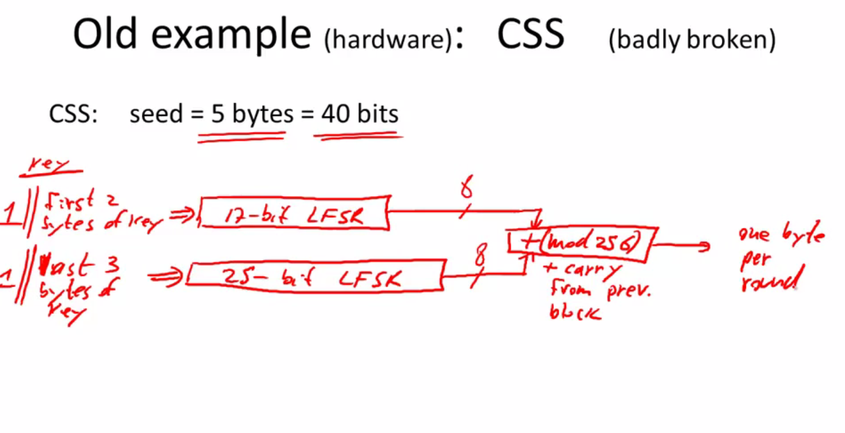

Slide 103
Cryptanalysis of CSS (2¹⁷ time attack)
17-bit LFSR
8
encrypted movie
+ (mod 256)
8
⊕
prefix
25-bit LFSR
8
CSS prefix
For all possible initial settings of 17-bit LFSR do:
Run 17-bit LFSR to get 20 bytes of output
Subtract from CSS prefix ⇒ candidate 20 bytes output of 25-bit LFSR
If consistent with 25-bit LFSR, found correct initial settings of both
Using key, generate entire CSS output
Notes:
Movies are Mpeg file so you know the Initial Prefix of the Movie and can generate the CSS prefix (PRG).
Let suppose that the prefix in 20bytes

Slide 104
Now let me show you how. So suppose you intercept the movies, so here we have an encrypted movie that you want to decrypt.
So let's say that this is all encrypted so you have no idea what's inside of here. However, it so happens that just because DVD encryption is using MPEG files, it so happens if you know of a prefix of the plaintext, let's just say maybe this is twenty bytes.
Well, we know if you XOR these two things together, so in other words, you do the XOR here, what you'll get is the initial segment of the PRG.
So, you'll get the first twenty bytes of the output of CSS, the output of this PRG.
So we have the first twenty bytes of the output. Now we do the following. We try all two to the seventeen possible values of the first LFSR.

Slide 105
So two to the seventeen possible values.
So for each value, so for each of these two to the seventeen initial values of the LFSR, we will run the LFSR for twenty bytes.
So we'll generate twenty bytes of outputs from this first LFSR, assuming—for each one of the two to the seventeen possible settings.
Now, remember we have the full output of the CSS system. So what we can do is we can take this output that we have.
And subtract it from the twenty bites that we got from the first LFSR, and if in fact our guess for the initial state of the first LFSR is correct, what we should get is the first twenty-byte output of the second LFSR.
Because that's by definition what the output of the CSS system is. Now, it turns out that looking at a 20-byte sequence, it's very easy to tell whether this 20-byte sequence came from a 25-bit LFSR or not.

Slide 106
If it didn't, then we know that our guess for the 17-bit LFSR was incorrect and then we move on to the next guess for the 17-bit LFSR and the next guess and so on and so forth.
Until eventually we hit the right initial state for the 17-bit LFSR, and then we'll actually get, we'll see that the 20 bytes that we get as the candidate output for the 25-bit LFSR is in fact a possible output for a 25-bit LFSR.
And then, not only will we have learned the correct initial state for the 17-bit LFSR, we will have also learned the correct initial state of the 25-bit LFSR.
And then we can predict the remaining outputs of CSS, and of course, using that, we can then decrypt the rest of the movie. We can actually recover the remaining plaintext

Slide 107
Modern stream ciphers: eStream (2008)
let's move on to better examples, and in particular the better pseudo-random generators come from what's called the eStream Project.
This is a project that concluded in 2008, and they qualify basically five different stream ciphers, but here I want to present just one.
So first of all the parameters for these stream ciphers are a little different than what we're used to.
So these stream ciphers as normal they have a seed. But in addition they also have, what's called a nonce.
So they take two inputs a seed and a nonce. And the of course they produce a very large output, so n here is much, much, much bigger than s.
Now, when I say nonce, what I mean is a value that's never going to repeat as long as the key is fixed

Slide 108
But for now, just think of it as a unique value that never repeats as long as the key is the same.
And so of course once you have this PRG, you would encrypt, you get a stream cipher just as before, except now as you see, the PRG takes as input both the key and the nonce.
And the property of the nonce is that the pair, (k, r) so the key and the nonce, is never—never repeats.
It's never used more than once. So the bottom line is that you can reuse the key, because the nonce makes the pair unique, because k and r are only used once.
So this nonce is kind of a cute trick that saves us the trouble of moving to a new key every time.
So the particular example from the eStream that I want to show you is called Salsa twenty. It's a stream cipher that's designed for both software implementations and hardware implementations.

Slide 109
Modern stream ciphers: eStream (2008)
PRG: {0,1}^{s} × R ⟶ {0,1}^{n}
Nonce: a non-repeating value for a given key.
E(k, m ; r) = m ⊕ PRG(k ; r)
The pair (k,r) is never used more than once.
Notes:
Parameters are different. Seed and Nounce
You can reuse the key. Since the nonce makes the pair unique.
This saves the trouble of moving to a new key every time.
Estream project called for improvement. 5 finalist and and we will discuss just one example

Slide 110
You realize that some stream ciphers are designed for software, like RC4.
Everything it does is designed to make software implementation run fast, whereas other stream ciphers are designed for hardware, like CSS, using an LFSR that's particularly designed to make hardware implementations very cheap

Slide 111
how Salsa works.
Salsa takes either 128 or 256-bit keys. We will see the 128-bit version of Salsa.
So this is the seed. And then it also takes a nonce, just as before, which
happens to be 64 bits. And then it'll generate a large output.
Now, how does it actually work? Well, the function itself is defined as follows.
Basically, given the key and the nonce, it will generate a very long, well, a long pseudorandom sequence, as long as necessary. And it'll do it by using this function that I'll denote by H.
This function H takes three inputs. Basically the key. Well, the seed k,
the nonce r, and then a counter that increments from step to step.
So it goes from zero to one, two, three, four as long as we need it to be.
So basically, by evaluating this H on this k r, but using this incrementing counter, we can get a sequence that's as long as we want.

Slide 112
So all I have to do is describe how this function H works.
Well, we start off by expanding the states into something quite large which is 64 bytes long, and we do that as follows.
Basically we stick a constant at the beginning, so there's tao zero, these are four bytes, it's a four byte constant, so the spec for Salsa basically gives you the value for tao zero.
Then we put k in which is sixteen bytes.
Then we put another constant. Again, this is four bytes.
And as I said, the spec basically specifies what this fixed constant is.
Then we put the nonce, which is eight bytes. Then we put the index. This is the counter zero, one, two, three, four, which is another eight bytes.
Then we put another constant tau two, which is another four bytes. Then we put the key again, this is another sixteen bytes.
And then finally we put the third constant, tau three, which is another four bytes. Okay so as I said, if you sum these up, you see that you get 64 bytes.

Slide 113
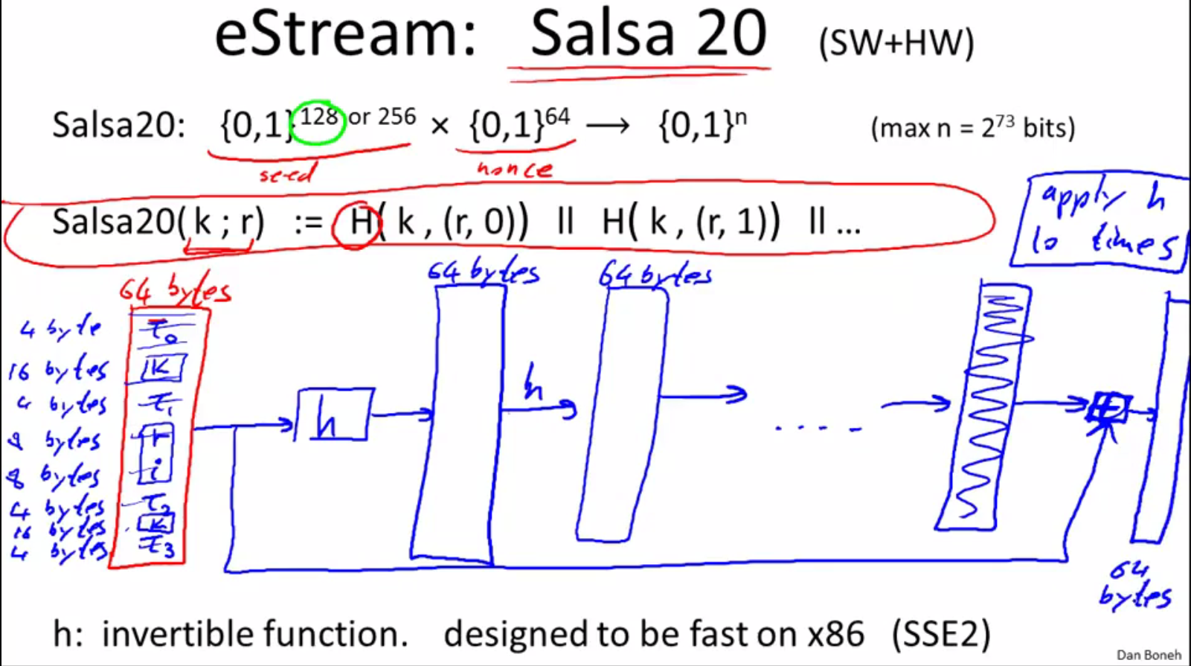

Slide 114
So basically we've expanded the key and the nonce and the counter into 64
bytes.
Basically the key is repeated twice.
And then what we do is we apply a function, we call this functional little h.
And this is a function that's one to one so it maps 64 bytes to 64 bytes.
It's a completely invertible function. So this function h is, an invertible function.

Slide 115
eStream: Salsa 20 (SW+HW)
Salsa20: {0,1} ¹²⁸ ^{or 256} × {0,1}⁶⁴ ⟶ {0,1}^{n}
Salsa20( k ; r) := H( k , (r, 0)) ll H( k , (r, 1)) ll …
0,1… are counters that goes from step to step
h: invertible function. designed to be fast on x86
τ₀ k τ₁ r i τ₂ k τ₃
kr
i
⊕
64 byte
output
h
(10 rounds)
32 bytes
64 bytes
64 bytes
Notes:
H takes key, nonce and counter
Xor is actually word-wise addition. τ_{i} fixed constant of 4 bytes, K = 16 bytes, r = 8 bytes, i =8bytes).
Easy to implement both is software and hardware.
What seems to be XOR is actually Addition to add randomness. Small h is completely invertible one-to-one function

Slide 116
So given the input you can get the output and given the output you can go back to the input.
And it's designed specifically so it's a- easy to implement in hardware and b- on an x86, it's extremely easy to implement because x86 has this SSE2 instruction set which supports all the operations you need to do for this function.
It's very, very fast. As a result, Salsa has a very fast stream cipher. And then it does this basically again and again. So it applies this function h again and it gets another 64 bytes. And so on and so forth, basically it does this ten times.
Okay so the whole thing here, say repeats ten times, so basically apply h ten times.
And then by itself, this is actually not quite random.
It's not gonna look random because like we said, H is completely invertible.
So given this final output, it's very easy to just invert h and then go back to the original inputs and then test that the input has the right structure. So you do one more thing, which is to basically XOR the inputs and the final outputs. Actually,
sorry. It's not an XOR. It's actually an addition.

Slide 117
So you do an addition word by word. So if there are 64 bytes, you do a word-by-word addition four bytes at a time, and finally you get the 64-byte output, and that's it. That's the whole pseudo-random generator.
So that, that's the whole function, little h. And as I explained, this whole construction here is the function big H.
And then you evaluate big H by incrementing the counter I from zero, one, two, three onwards. And that will give you a pseudo-random sequence that's as long as you need it to be.
And basically, there are no significant attacks on this.
This has security that's very close to two to the 128. We'll see what that means more precisely later on.
It's a very fast stream cipher, both in hardware and in software.
And, as far as we can tell, it seems to be unpredictable as required for a stream cipher. So I should say that the eStream project actually has five stream ciphers like
this.

Slide 118
Is Salsa20 secure (unpredictable) ?
Unknown: no known provably secure PRGs
In reality: no known attacks better than exhaustive search

Slide 119
Performance:
AMD Opteron, 2.2 GHz ( Linux)
PRG Speed (MB/sec)
RC4 126
Salsa20/12 643
Sosemanuk 727
eStream

Slide 120
I only chose Salsa ‘because I think it's the most elegant. But I can give you some performance numbers here.
So you can see, these are performance numbers on a 2.2 gigahertz, you know, x86 type machine.
And you can see that RC4 actually is the slowest. Because essentially, well it doesn't really take advantage of the hardware. It only does byte operations. And so there's a lot of wasted cycles that aren't being used.
But the E-Stream candidates, both Salsa and other candidate called Sosemanuk. I should say these are eStream finalists.
These are actually stream ciphers that are approved by the eStream project. You can see that they have achieved a significant rate.
This is 643 megabytes per second on this architecture, more than enough for a movie and these are actually quite impressive rates. And so now you've seen examples of two old stream ciphers that shouldn't be used, including attacks on those stream ciphers. You've seen what the modern stream ciphers look like with this nonce. And you see the performance numbers for these modern stream ciphers so if you happen to need a stream cipher you could use one of the eStream finalists. In particular you could use something like Salsa.

Slide 121
Acknowledgements
Material in this lecture are taken from the slides prepared by:
Prof. Dr. Konrad Rieck (Uni-Göttingen)
Prof. Dan Boneh (Stanford)
Prof. Dr. Sufian Hameed
Edited by Lecturer Abdullah Bin Zarshaid

